Slide 1
Making cities greener
Maths and the environment

Slide 2
How our teaching resources are designed for the classroom

Slide 3
I can understand various approaches to improve local environments.

Slide 4
A forecast is a prediction of a future event occurring (based on data).
Extrapolation is the process of estimating unknown values that are outside the range of existing data.
Climate is the average weather pattern in an area across a long period of time.
Urban is a word to describe a town or city, or certain properties of towns and cities.

Slide 5

Making cities greener
The importance of urban greening
The maths behind urban greening

Slide 6
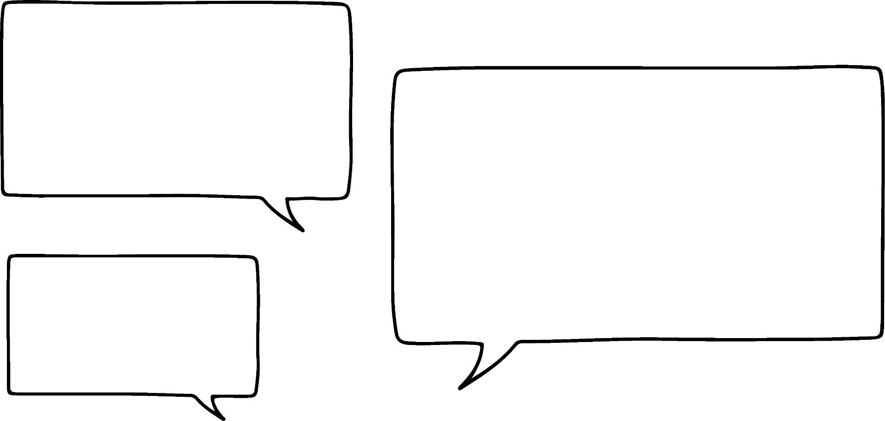
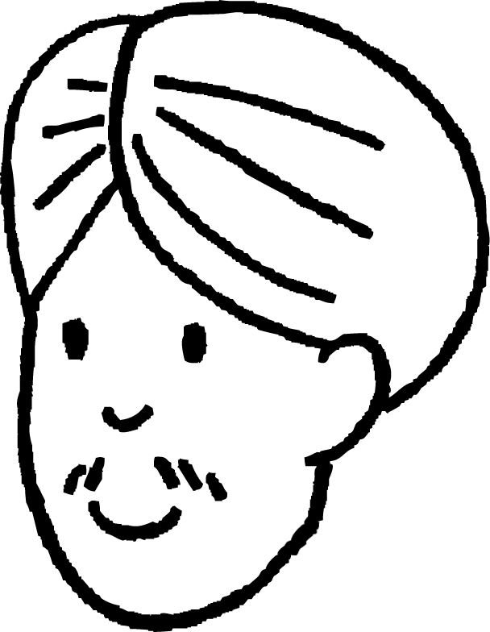

The importance of urban greening
Apparently, making towns and cities greener is really important!
Okay… But what does making somewhere “greener” actually mean?
Andeep
Jun

Slide 7
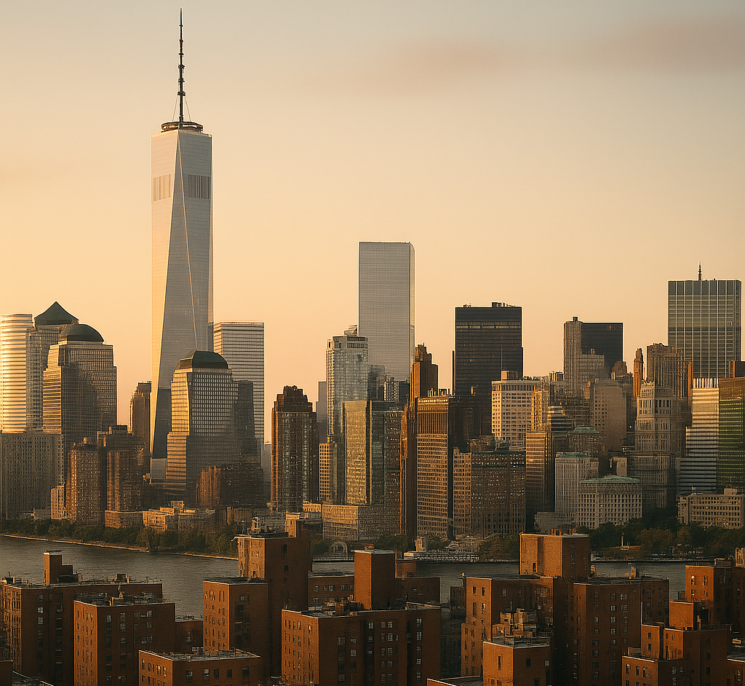
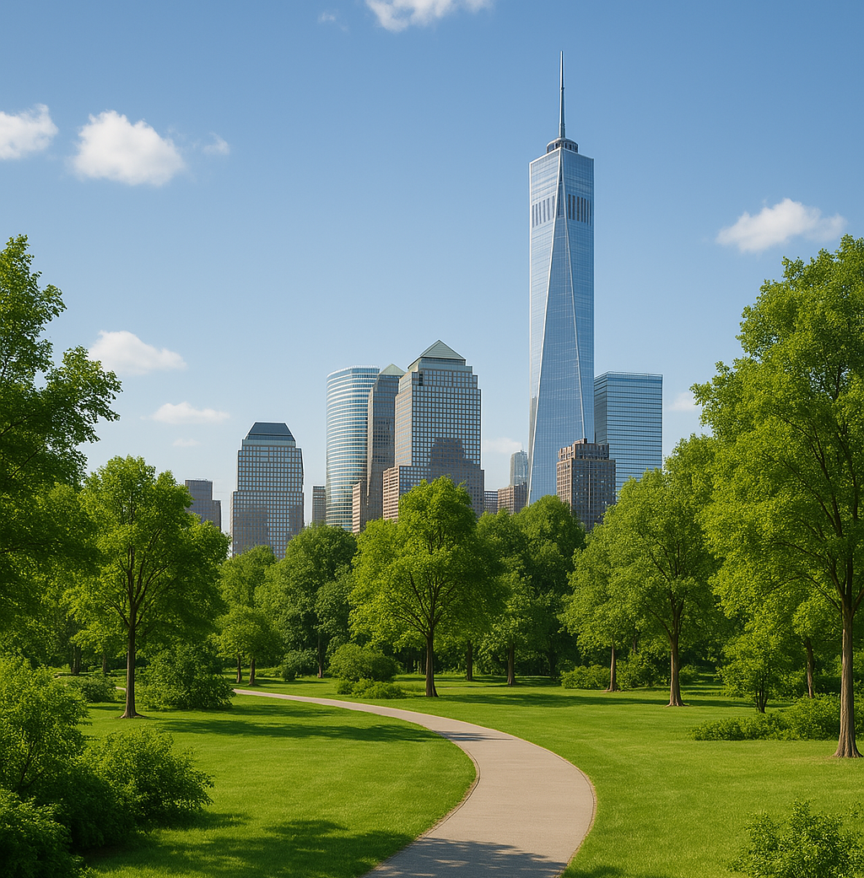
The importance of urban greening
There are many elements to making towns and cities “green” (also called urban greening).
Typically, an urban environment has:
high density of buildings
many roads (and the traffic that goes with it)
carbon emissions from vehicles and factories
Urban greening aims to incorporate more green space (such as parks and trees) into an urban environment, and promote sustainability for its citizens, its infrastructure, and its transportation.

Slide 8


The importance of urban greening
Which of these are urban greening strategies?
a
Adding parks to cities
b
Adding more buildings to the countryside (which is green)
c
Adding trees to streets in the city
d
Promoting sustainable and public transport options in a city
e
Painting more buildings in the city green

Slide 9
The importance of urban greening
So, urban greening is about making a city more natural and sustainable. Why is that important?
Urban greening has many benefits to both the environment and the population of that town or city.
Jun
Increasing the amount of green spaces may result in…
an increase in the diversity of wildlife in the city
improving air quality in the city
offsetting carbon emissions (due to the oxygen released by plants and trees)
improving well-being

Slide 10
The importance of urban greening
So, urban greening is about making a city more natural and sustainable. Why is that important?
Urban greening has many benefits to both the environment and the population of that town or city.
Jun
Promoting sustainability may result in…
improving air quality in the city
reducing carbon emissions (both due to fewer vehicles being used in the city)
reducing noise pollution
reducing wastage of resources

Slide 11
The importance of urban greening
Over time, the population in urban areas has increased a lot.
What possible problems might result from an increase in urban population?
a
More vehicles on the road, resulting in more frequent traffic
b
More vehicles on the road, resulting in higher carbon emissions
c
More vehicles on the road, resulting in smaller cars being built
d
Increase in people with important & helpful skill sets in a small area
e
Increase in pressure on local facilities such as local hospitals
f
More buildings being built in a limited/restricted space

Slide 12
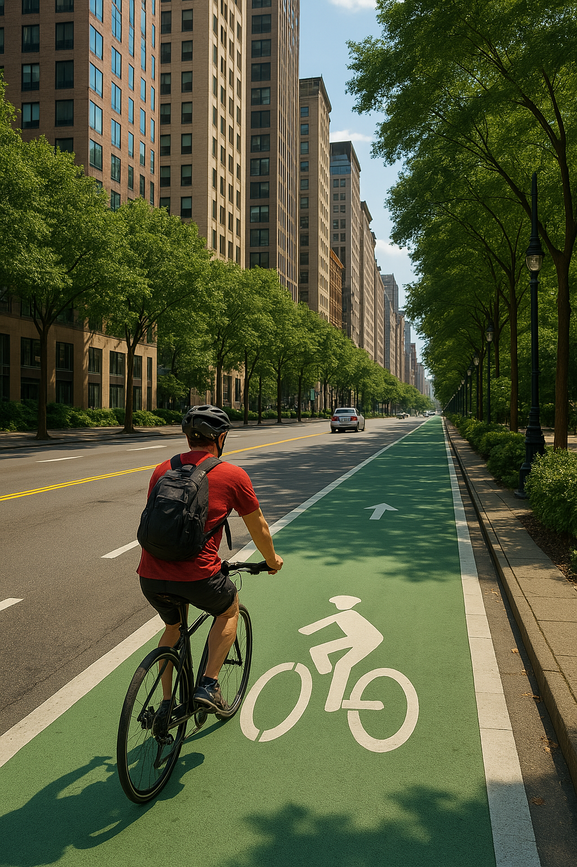
The importance of urban greening
One strategy for urban greening is to build more cycle lanes around the city.
Which of these are benefits of cycle lanes?
a
Increases wildlife
b
Reduces carbon emissions
c
Improves health and well-being of commuters
d
Reduces noise pollution
e
Reduces the price of cars sold in cities

Slide 13
The importance of urban greening
Which of these are ways an urban living environment can become more sustainable?
a
Solar panels on top of buildings (to reduce reliance on fossil fuels)
b
Taller buildings (to increase the number of people in a building)
c
Insulated buildings (to reduce need for heating in the winter)
d
Rooftop gardens / allotments (to promote independent agriculture / growing of food)

Slide 14
The importance of urban greening
1) Imagine you were the mayor of a medium-sized city, and were given the task of adding two different urban greening strategies of your choice to the city.
a) Which two strategies do you think would be the most cost effective to implement? Explain why.
b) Which two strategies do you think would be most effective at improving the well-being of the population of the city? Explain why.
c) Which two strategies do you think would be most effective at improving the sustainability of the city? Explain why.
(You can use the same strategy for more than one question.)

Slide 15
The importance of urban greening
2) Several old cities in the UK have tried to implement urban greening strategies, but have struggled to do so.
Give one possible reason why.

Slide 16
The importance of urban greening
1) Imagine you were the mayor of a medium-sized city, and were given the task of adding two different urban greening strategies of your choice to the city.
a) Which two strategies do you think would be the most cost effective to implement? Explain why.
(Any answer may be valid with the correct justification).
Examples include:
Cycle lanes - some roads may be made one-way only, allowing the other half of the road to be turned into cycle lanes. No new cycle lanes need to be built.
Trees in streets - tree saplings can be planted along different streets.

Slide 17
The importance of urban greening
1) Imagine you were the mayor of a medium-sized city, and were given the task of adding two different urban greening strategies of your choice to the city.
b) Which two strategies do you think would be most effective at improving the well-being of the population of the city? Explain why.
Examples include:
Green parks - people in the city will have easier-to-access green spaces to enjoy walks, a relaxing space for their lunch, etc.
Improve public transport options - people may worry less about travelling to work on time on public transport. Options for travel are increased, or became more reliable.

Slide 18
The importance of urban greening
1) Imagine you were the mayor of a medium-sized city, and were given the task of adding two different urban greening strategies of your choice to the city.
c) Which two strategies do you think would be most effective at improving the sustainability of the city? Explain why.
Examples include:
Improve public transport options - fewer people using cars on their own means a reduction in carbon emissions. This is especially true if the public transport uses electric vehicles.
Insulated buildings - the cost and energy consumption when heating a house during the winter can be very high.

Slide 19
The importance of urban greening
2) Several old cities in the UK have tried to implement urban greening strategies, but have struggled to do so.
Give one possible reason why.
Old cities that have grown larger over time may not have grown with urban greening in mind.
This means these cities may not have the space for urban green parks, or the roads may not be wide enough to accommodate cycle lanes, routes for large buses, trains or trams, etc.

Slide 20
Making cities greener
The importance of urban greening
The maths behind urban greening

Slide 21
The maths behind urban greening
In 2020, the city of Leeds had the highest level of transport emissions of any local authority in the UK, at 1471.6 kt (kilotonnes) of CO₂ that year.
An effective urban greening initiative may result in the following carbon emission reduction over a 5 year period:
residential | 5% reduction
industry | 12.5% reduction
transport | 15% reduction

Slide 22
The maths behind urban greening
In 2020, the city of Leeds had the highest level of transport emissions of any local authority in the UK, at 1471.6 kt (kilotonnes) of CO₂ that year.
What might have been the carbon emissions from transport in Leeds in 2025 if an urban greening initiative was implemented in 2020?
A 15% reduction means the carbon emissions will be (100 – 15)% = 85% of what it was before.
An effective urban greening initiative may result in the following carbon emission reduction over a 5 year period:
85% = 0.85
residential | 5% reduction
industry | 12.5% reduction
transport | 15% reduction
Therefore, the transport carbon emissions from Leeds could have been:
(0.85 × 1471.6) kt = 1250.86 kt

Slide 23
The maths behind urban greening
According to the ONS (2021), Leeds has the second largest population of any local authority in the UK.
Therefore, it makes sense that the larger population will produce a large quantity of transport carbon emissions.
Funding for urban greening initiatives may prefer to target local authorities that have the highest average transport carbon emissions per person in the population.
 | transport emissions | population
Leeds | 1471.6 kt | 809 036
Rotherham | 540.7 kt | 266 183
North Warwickshire | 488.2 kt | 65 340
emissions per person
0.0018
0.0020
0.0075
Which of these three local authorities might be preferred for urban greening funding?
North Warwickshire

Slide 24
The maths behind urban greening
What will the average transport carbon emissions per person be in North Warwickshire in 2025 after an estimated 15% reduction in emissions due to urban greening (3 s.f.)?
 | transport emissions | population
Leeds | 1471.6 kt | 809 036
Rotherham | 540.7 kt | 266 183
North Warwickshire | 488.2 kt | 65 340
488.2 × 0.85 = 414.97
Total of 414.97 kt of CO₂.
414.97 ÷ 65 340 = 0.00635
0.00635 kt of CO₂ per person.

Slide 25
The maths behind urban greening
What will the average transport carbon emissions per person be in North Warwickshire in 2025 after an estimated 15% reduction in emissions due to urban greening (3 s.f.)?
Give one possible reason why the estimation of future CO₂ emissions per person may not be accurate?
The population of North Warwickshire may change before 2025.
 | transport emissions | population
Leeds | 1471.6 kt | 809 036
Rotherham | 540.7 kt | 266 183
North Warwickshire | 488.2 kt | 65 340
488.2 × 0.85 = 414.97
Total of 414.97 kt of CO₂.
414.97 ÷ 65 340 = 0.00635
0.00635 kt of CO₂ per person.

Slide 26
The maths behind urban greening
Some urban greening initiatives require large spaces.
Urban green parks require large areas that can be converted or “renewed”.
This means there have to be large empty spaces that can be renewed into parks. For older cities, this is quite rare.
Or, it means that there are large areas of derelict (old and unused) buildings that must be knocked down before the space can be renewed. This is incredibly costly and adds time to the project.
Cycle lanes require roads and connecting routes to be safe.
Inner city roads have to be wide enough to split parts off into cycle lanes (minimum width of 1.5 m, recommended width of 2 m).
Off-road routes between parts of the city need to be unobstructed.

Slide 27
The maths behind urban greening
According to the ONS, Doncaster borough has a total area of approximately 569 km².
Approximately 0.75% of land in Doncaster borough is classified as “brownfield areas”, which are disused areas which can be repurposed.
A medium-sized urban green park can be around 3 km² in area.
Is there enough “brownfield area” in Doncaster that can be renewed into a medium-sized urban green park?
0.75% = 0.0075
Yes, there is 4.2675 km² of brownfield area that can be renewed into an urban green park.
0.0075 × 569 = 4.2675

Slide 28
The maths behind urban greening
According to the ONS, Doncaster borough has a total area of approximately 569 km².
Approximately 0.75% of land in Doncaster borough is classified as “brownfield areas”, which are disused areas which can be repurposed.
A medium-sized urban green park can be around 3 km² in area.
What assumption is being made when saying that “4.2675 km² of area can be renewed into an urban green park”?
The assumption is that this area is in one location, and not several smaller brownfield areas scattered around Doncaster. If the brownfield areas are scattered, then it cannot be renewed into one medium-sized park.

Slide 29
The maths behind urban greening
1) The urban city of Oakfield has been given £ 10 000 000 of funding to start an urban greening initiative.
Using the table of information about Oakfield and the cost of each urban greening strategy, recommend a set of effective urban greening strategies (and how much of the city it will apply to) that Oakfield can afford to implement.
transport carbon emissions | 461.3 kt
population | 102 504
total area of city | 98 km²
area available for renewal | 23 km²
area of bus depot. | 7500 m²
yearly total sunshine hours | 1356 hours
planting trees along streets (requires average of 3.5 hours of daily sunshine) | £17 000 per km²
cycle lanes (suggested only if transport carbon emissions per person are over 0.004 kt) | £4 100 000
urban park renewal (requires 25% of city area to be available) | £35 000 per km²
electric, zero-emission buses (area of 200 m² required per bus) | £320 000 per bus

Slide 30
The maths behind urban greening
2) Discuss possible limitations of your proposed urban greening initiative in question 1.

Slide 31
The maths behind urban greening
1) The urban city of Oakfield has been given £ 10 000 000 of funding to start an urban greening initiative.
Using the table of information about Oakfield and the cost of each urban greening strategy, recommend a set of effective urban greening strategies (and how much of the city it will apply to) that Oakfield can afford to implement.
transport carbon emissions | 461.3 kt
population | 102 504
total area of city | 98 km²
area available for renewal | 23 km²
area of bus depot. | 7500 m²
yearly total sunshine hours | 1356 hours
The quantity of transport carbon emission per person is: 0.0045 kt (2 s.f.)
The percentage area of the city available for renewal is 23% (2 s.f.)
The average daily amount of sunshine is 3.7 hours (2 s.f.)

Slide 32
The maths behind urban greening
1) The urban city of Oakfield has been given £ 10 000 000 of funding to start an urban greening initiative.
Using the table of information about Oakfield and the cost of each urban greening strategy, recommend a set of effective urban greening strategies (and how much of the city it will apply to) that Oakfield can afford to implement.
planting trees along streets (requires average of 3.5 hours of daily sunshine) | £17 000 per km²
cycle lanes (suggested only if transport carbon emissions per person are over 0.004 kt) | £4 100 000
urban park renewal (requires 25% of city area to be available) | £35 000 per km²
electric, zero-emission buses (area of 200 m² required per bus) | £320 000 per bus
At 3.7 hours per day average, this strategy is available.
At 0.0045 kt per person, this strategy is available.
At only 23% area available, this strategy is not available.
A maximum of 37 buses can fit in the depot.

Slide 33

The maths behind urban greening
1) The urban city of Oakfield has been given £ 10 000 000 of funding to start an urban greening initiative.
Oakfield cannot afford all three strategies, as their total cost is £17 606 000.
planting trees along streets (requires average of 3.5 hours of daily sunshine) | £17 000 per km²
cycle lanes (suggested only if transport carbon emissions per person are over 0.004 kt) | £4 100 000
urban park renewal (requires 25% of city area to be available) | £35 000 per km²
electric, zero-emission buses (area of 200 m² required per bus) | £320 000 per bus
Cost for whole city (area 98 km²) is £1 666 000.
Fixed at £4 100 000.
Cost for all 37 buses is £11 840 000.

Slide 34
The maths behind urban greening
1) The urban city of Oakfield has been given £ 10 000 000 of funding to start an urban greening initiative.
However, it is possible to have the cycle lanes and all the street trees, plus 13 electric buses (at £4 160 000).
planting trees along streets (requires average of 3.5 hours of daily sunshine) | £17 000 per km²
cycle lanes (suggested only if transport carbon emissions per person are over 0.004 kt) | £4 100 000
urban park renewal (requires 25% of city area to be available) | £35 000 per km²
electric, zero-emission buses (area of 200 m² required per bus) | £320 000 per bus
Cost for whole city £1 666 000.
Fixed £4 100 000.
Cost for all 37 buses is £11 840 000.

Slide 35
The maths behind urban greening
1) The urban city of Oakfield has been given £ 10 000 000 of funding to start an urban greening initiative.
Or the cycle path, some street trees, and a greater number of electric buses.
planting trees along streets (requires average of 3.5 hours of daily sunshine) | £17 000 per km²
cycle lanes (suggested only if transport carbon emissions per person are over 0.004 kt) | £4 100 000
urban park renewal (requires 25% of city area to be available) | £35 000 per km²
electric, zero-emission buses (area of 200 m² required per bus) | £320 000 per bus
Cost for whole city £1 666 000.
Fixed £4 100 000.
Cost for all 37 buses is £11 840 000.

Slide 36
The maths behind urban greening
2) Discuss possible limitations of your proposed urban greening initiative in question 1.
A large assumption is that the entire area of Oakfield is “street” that can have trees planted on them.
In reality, the area of Oakfield that is “street” might be a lot less than 98 km², since a lot of the land will either be buildings or roads.
Another assumption is that all the roads are wide enough, and off-road locations are safe and unobstructed enough, to have cycle lanes built on them.

Slide 37
Making cities greener
Urban greening is the process of adding green parks, trees, cycle lanes, and other initiatives that improve the sustainability of a town or city, improve the mental wellbeing of its population, and offset / reduce its carbon footprint.
The impact of urban greening on reducing carbon emissions can be quantified.
Different urban greening initiatives will cost different amounts of money. Each initiative will be either viable or unviable, depending on the specific properties of each area.

Slide 38

© Oak National Academy 2024.
Produced in partnership with Mathematics in Education and Industry.
Licensed on the Open Government Licence v3.0, except where otherwise stated. See Oak terms and conditions.

